Slide 1

Introduction to
Frontend Engineer

Slide 2

Wellcome

Slide 3
# Aufa Billah - @aufaroot18
Angkatan 2015 - 2019 (3.86)
Beasiswa STT-NF
# Experience and Organization
Assistant Lecturer - STT-NF (2016 - Recent)
Frontend Engineer - YABB (2021)
Web Developer - IQR Foundation (2020)
Web Developer - Alkhatech (2018).
Content Writer & Editor (2015 - 2019).
BEM STT-NF (2016 - 2019).
Google DSC STT-NF (2018).
Seirama (2018).
Cordofa Dompet Dhuafa (2018).
Senada (2017)
# Certifications and Licenses
Frontend Engineer - YABB Gojek
Frontend Expert - Dicoding.
Backend Certification - Freecodecamp.
Github - Medium - Linkedin - Instagram

Slide 4
Schemes

Slide 5



# Components
5%
Attendance
35%
Task & Practice
60%
UTS & UAS

Slide 6


# Make Your Choice
A
Take it all
C-
Just take final
D
Just take task
E
Plagiarism
Should be C to pass the course.

Slide 7



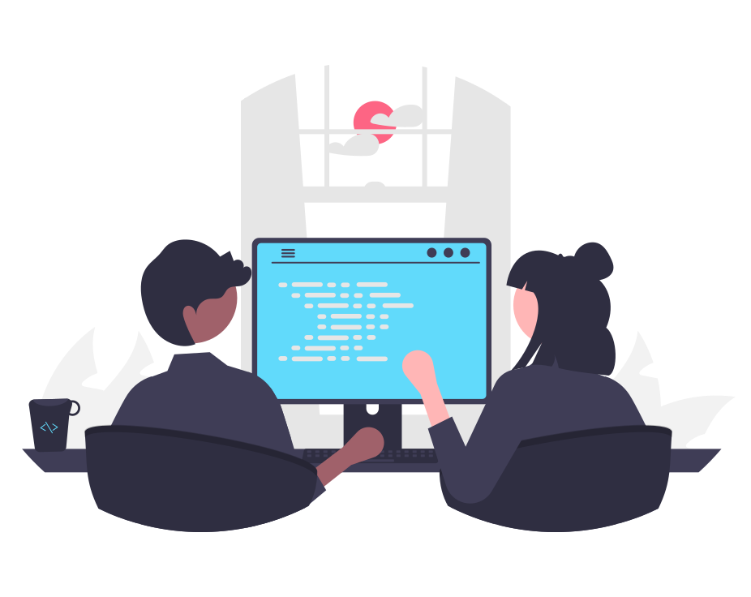
# Great Software Engineer
On Time
Attendance, Task, Final
Passion
Practice more and more
Read
Documentation
Be
Curious

Slide 8
# Just Say Goodbye
Say hello next semester who does plagiarism.
Types: Share, Ask, Copy Paste (Github/Others).
Final project: Test, Code Review.
Sorry, no fixing bestie.

Slide 9
# Need More Coffee?
Take Freecodecamp Front-End Certification: Link.
Passed all courses and completed 1 of 5 project.
Timeline: 17 Februari - 18 Juni 2022.
Only who meets all requirements are accepted.

Slide 10
# On Time
Task will be opened for a week.
UTS and UAS will be opened for 2 weeks (based on agreement).
Assignment will be closed automatically.
No extra time (this is not football).

Slide 11



# Keep Connected
Elena Course
WA Group
Github Repository

Slide 12
Prerequisites

Slide 13
# Basic Knowledge
HTML:
Basic: Tag, Element, Attribute, Class, ID.
Basic Element: Paragraph, Heading, List, Hyperlinks.
Image, Form, Table.
Layout: div, span, header, main, footer, nav.
CSS:
Selector: Type, Class, ID, Attribute, Pseudo, Combinators.
Box Model: Margin, Padding, Border, Content, Width, Height.
Styling Text: Color, Background, Font Family, Font Size.
CSS Layout: Flexbox, Grid.

Slide 14
# Relearn Basic
Resources:
Please take one and finish him.
Net Ninja: HTML & CSS Crash Course.
Freecodecamp: HTML & CSS Project Tutorial - Build a Recipes Website.
MDN (Mozilla): HTML - Structuring the Web.
MDN (Mozilla): CSS - Styling the Web.
Others are welcome.

Slide 15
# How is JavaScript?
Will be covered:
JavaScript Basic.
JavaScript Modern (ES6).
JavaScript OOP.
JavaScript Asynchronous.

Slide 16
Frontend

Slide 17

# What Frontend is
Frontend Web Developer.
Frontend Mobile Developer.
Frontend Engineer.

Slide 18


# UI/UX vs Frontend
UI/UX
Design
Frontend
Code

Slide 19
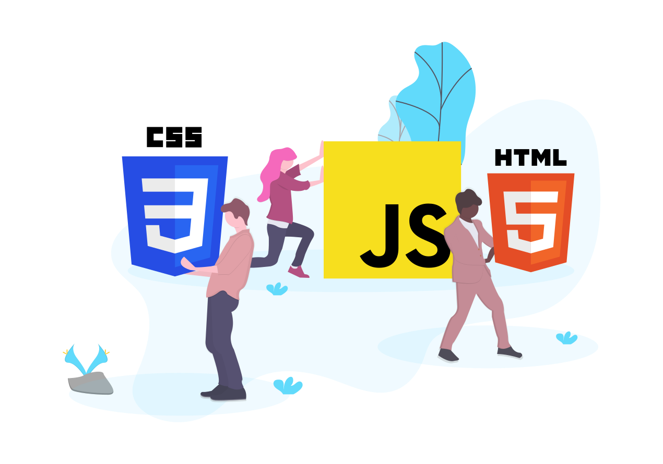
# Why is Frontend?
I Am
Frontend Engineer

Slide 20


Backend
Laravel
View
HTML/CSS/JS
Monolithic
Arsitektur yang menggabungkan semua komponen menjadi satu.
intinya: Backend dan Frontend disatukan menjadi satu komponen.

Slide 21
How to scale up?
Used by other systems?
Decouple
Frontend
Backend

Slide 22

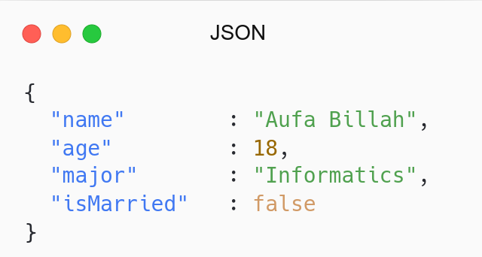

Frontend
Web
Backend
Laravel
Frontend
Mobile
Microservices
Arsitektur yang memisahkan setiap layanan menjadi bagian kecil.
intinya: Backend dan Frontend dipisahkan menjadi komponen berbeda.

Slide 23

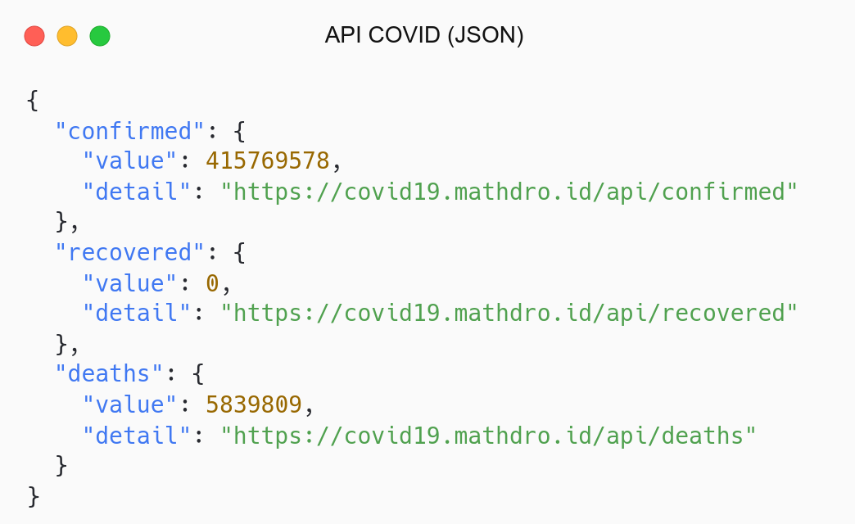
Covid Website (React)
Covid API
Covid Website (Vanilla)

Slide 24
# Skills
Foundation:
HTML: Create Structure.
CSS: Give Styling.
JavaScript: Add interactivity and dynamic.
Stack:
Framework CSS: Tailwind, Bootstrap.
CSS Preprocessor: SASS, PostCSS.
Bundler: Webpack, Parcel.
Library/Framework JavaScript: React, Vue, Svelte.
Framework over Framework: Next (React), Nuxt (Vue), Sapper (Svelte).
Testing: Jest, Cypress, React Testing Library

Slide 25
# Responsibility
Code UI.
Responsive Web Design.
Consuming API.
Improve Performance & Accessibility.
Testing: Unit Test, Integration, Browser Testing.
Create Design System.

Slide 26
# Our Stack
Library | State | Styling | Routing | Fetch | Form
React.js | Hooks (I) | CSS Modules (I) | React Router (E) | Fetch (I) | React (I)
 | Context (I) | Styled Component (E) |  | Axios (E) | React Hook Form (E)
 | Redux (E) | Tailwind (E) |  | React Query (E) | Formik (E)
I: Internal (default)
E: External (third party)

Slide 27

# Our Guide
JavaScript Info
The Modern JavaScript Tutorial
React
React Documentation

Slide 28


# Projects
Hands-on
Movie App Database
Final Project
Covid Monitoring

Slide 29
Tools

Slide 30
# Write your Code
Text Editor:
Don’t code in notepad or microsoft word, but Vim is welcome.
Download and Install VSCode: Link.
Others are welcome.
Extensions:
Prettier: Code formatter.
ESLint: Find problems.
Live Server: Hot reload.

Slide 31
# Run JavaScript Environment
Install Node.js:
Choose LTS Version.
Windows: Link.
Linux (Debian Based): Link.
Linux (Others): Link.
Verify:
Verify Node: node -v.
Verify NPM: npm -v.

Slide 32
# Testing API
Postman: Link.
Insomnia: Link.
Others are welcome.

Slide 33
# Get Stuck with Tools?
Online code editor:
Register Stack Blitz: Link.
Choose React Project.
Creat.

Slide 34
Take Away

Slide 35
# Make Sure
Setup Tools (Primary).
Re-learn HTML and CSS (Primary).
Learn JavaScript Modern (Secondary).
JavaScript Resources:
Please take one and finish him.
Net Ninja: Modern JavaScript Tutorial.
Freecodecamp: Full JavaScript Course.
Mozilla: A re-introduction to JavaScript.
Others are welcome.

Slide 36
QnA

Slide 37
Attendance

Slide 38
Thanks

